Slide 1


Machine Learning Retrieval of Near-Real-Time 3D EarthCARE Scenes from MTG-FCI Observations
Stella Girtsou, Dimitra Karkani, Aggelos Georgakis, Giorgos Giannopoulos, Charalambos Kontoes, Alexandra Tsekeri
National Observatory of Athens

Slide 2
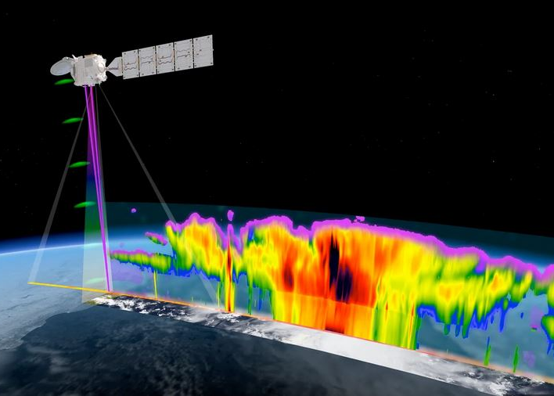
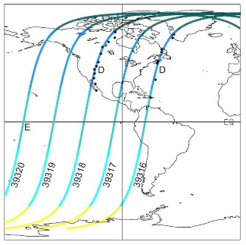
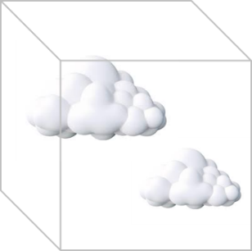
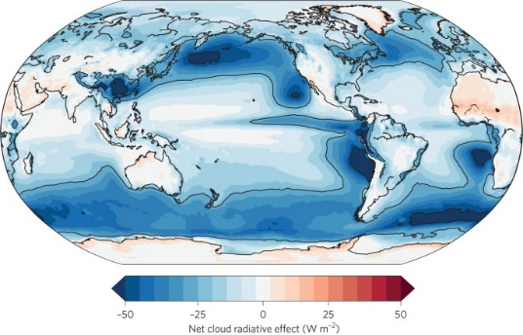


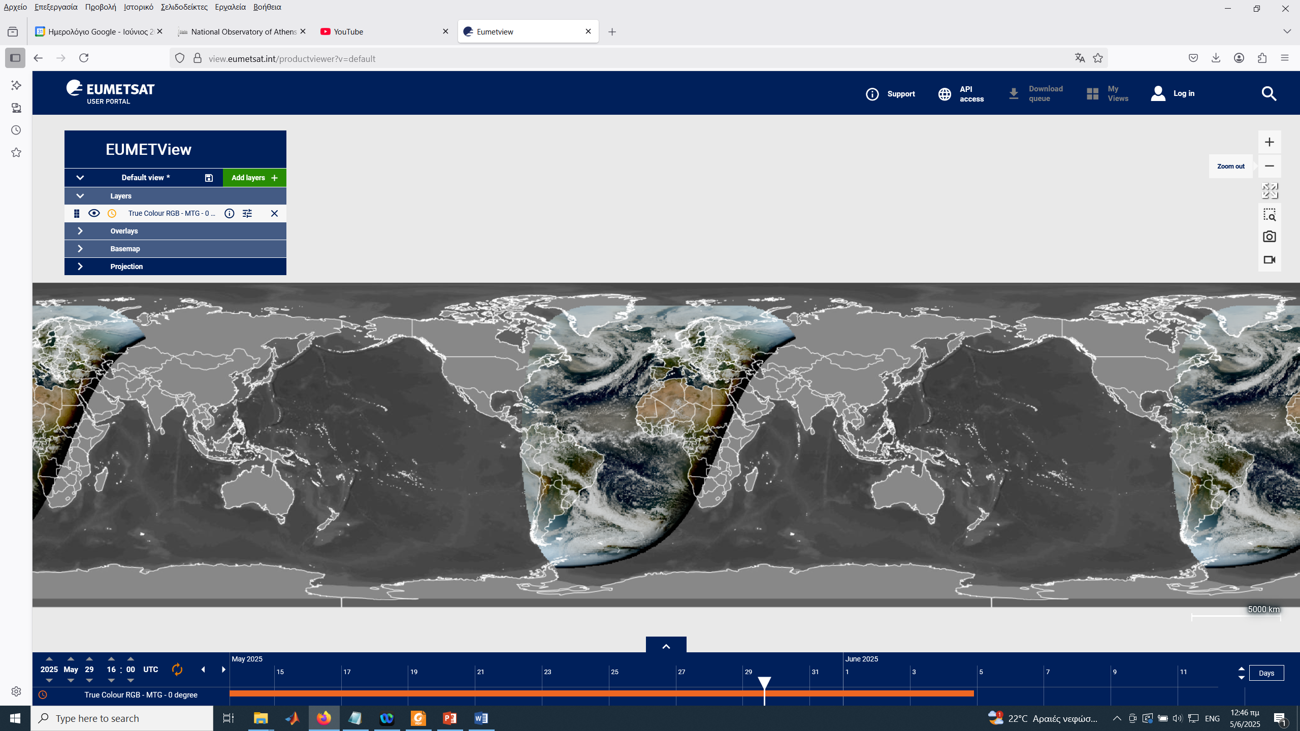

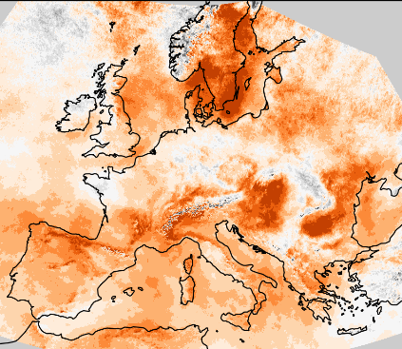


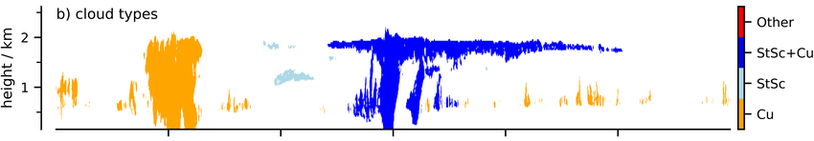
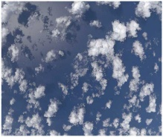
Obs3Rve Overview
Input
Products
Scientific impact
Synergy with ESA/EC projects
EarthCARE 3D product
EarthCARE
Cloud radiative effect
MTG 3D product
Solar radiation/energy
MTG
Validation

Slide 3
Machine Learning for 3D Cloud Scene Construction
Enhance the 3D RT capabilities of EarthCARE using machine learning and MTG data with the construction of realistic 3D scenes
Real-time Cloud Maps at Europe and the Atlantic Ocean.
Input: FCI/MTG radiances
Output: 3D maps of cloud types and cloud microphysical properties (i.e. liquid water content, ice water content, effective radius)
Global Cloud Maps
Input: EarthCARE MSI radiances, CPR reflectivity profiles, ATLID backscatter profiles
Output: 3D maps of cloud types and cloud microphysical properties (i.e. liquid water content, ice water content, effective radius)
Based on the FDL work
3D Cloud reconstruction through geospatially-aware Masked Autoencoders, Stella Girtsou, Emiliano Diaz Salas-Porras, Lilli Freischem, Joppe Massant, Kyriaki-Margarita Bintsi, Guiseppe Castiglione, William Jones, Michael Eisinger, Emmanuel Johnson, Anna Jungbluth

Slide 4
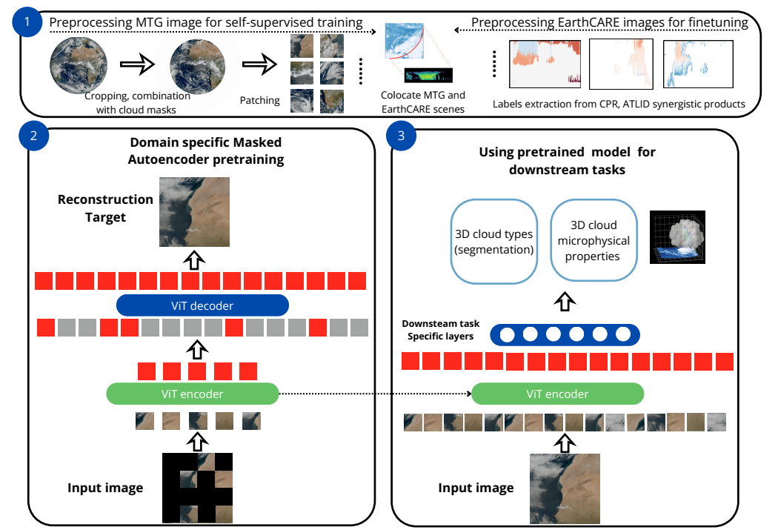
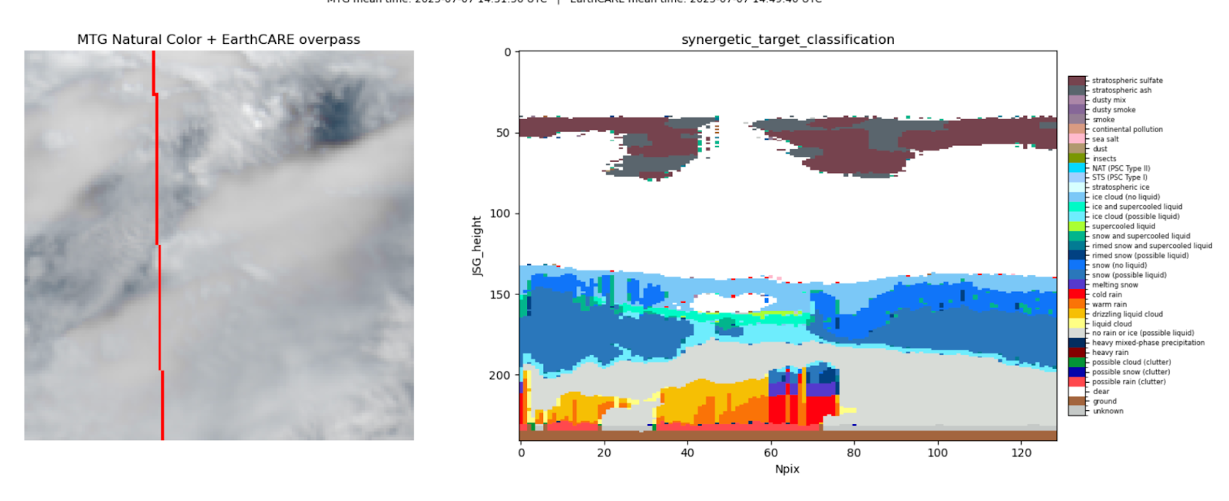
ML methodology

Slide 5
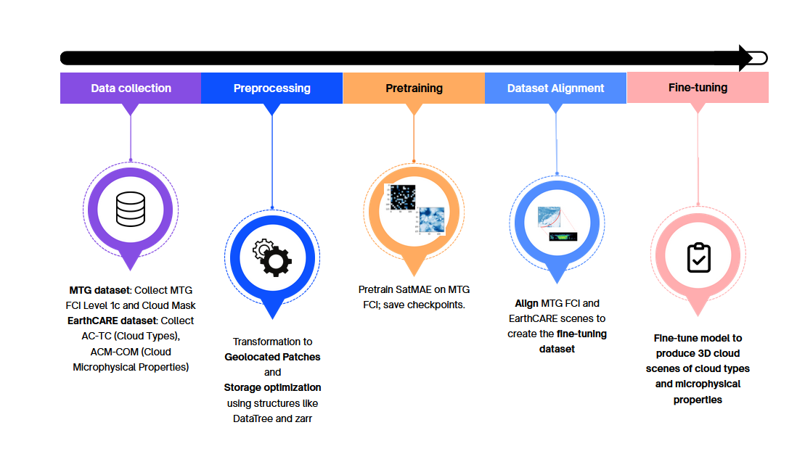
Pipeline

Slide 6
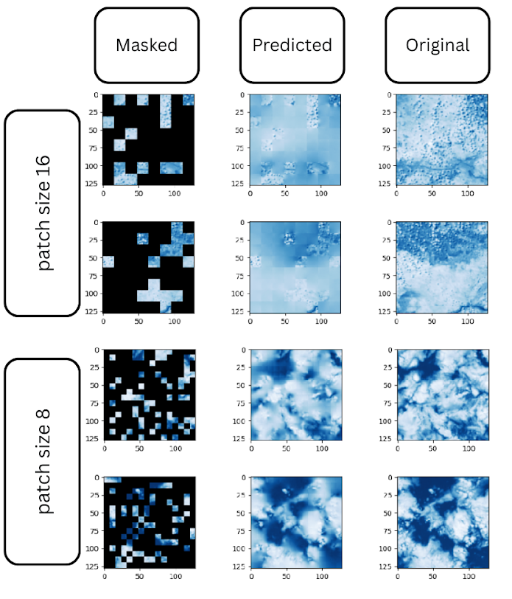
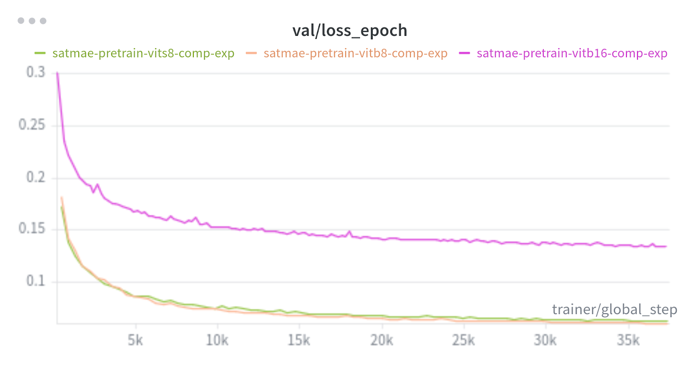
Pretraining
Experiments | Architecture | Patch size
1 | ViT Base | 16
2 | ViT Base | 8
3 | ViT Small | 8
Epochs: 200
Learning Rate: 1.5e-4
Masking Ratio: 0.75
Image size: 128
Time encoding

Slide 7
Finetuning
Classes grouping: EarthCARE AC-TC target classifications gives 35 classes - not all relevant to clouds
Tried 3 different groupings created based on classes imbalance and no precipitation distinction
Architectures: 2 different finetuning architectures, one with only 2 layers and one with more layers and skip connections
Class weights: Major class imbalance on certain cloud types addressed with various class weights
Loss functions: 10 different ways to train our network and make it learn the difficult patterns
  Cross-Entropy Loss: compares predicted probabilities with the true class labels.
  Dice Loss: optimizes overlap between prediction and ground truth
  Tversky Loss: weights false positives and false negatives differently, making it useful for imbalanced segmentation tasks.
  Focal Loss: Focuses training on hard-to-classify examples helping improve performance on minority or difficult classes.

Slide 8
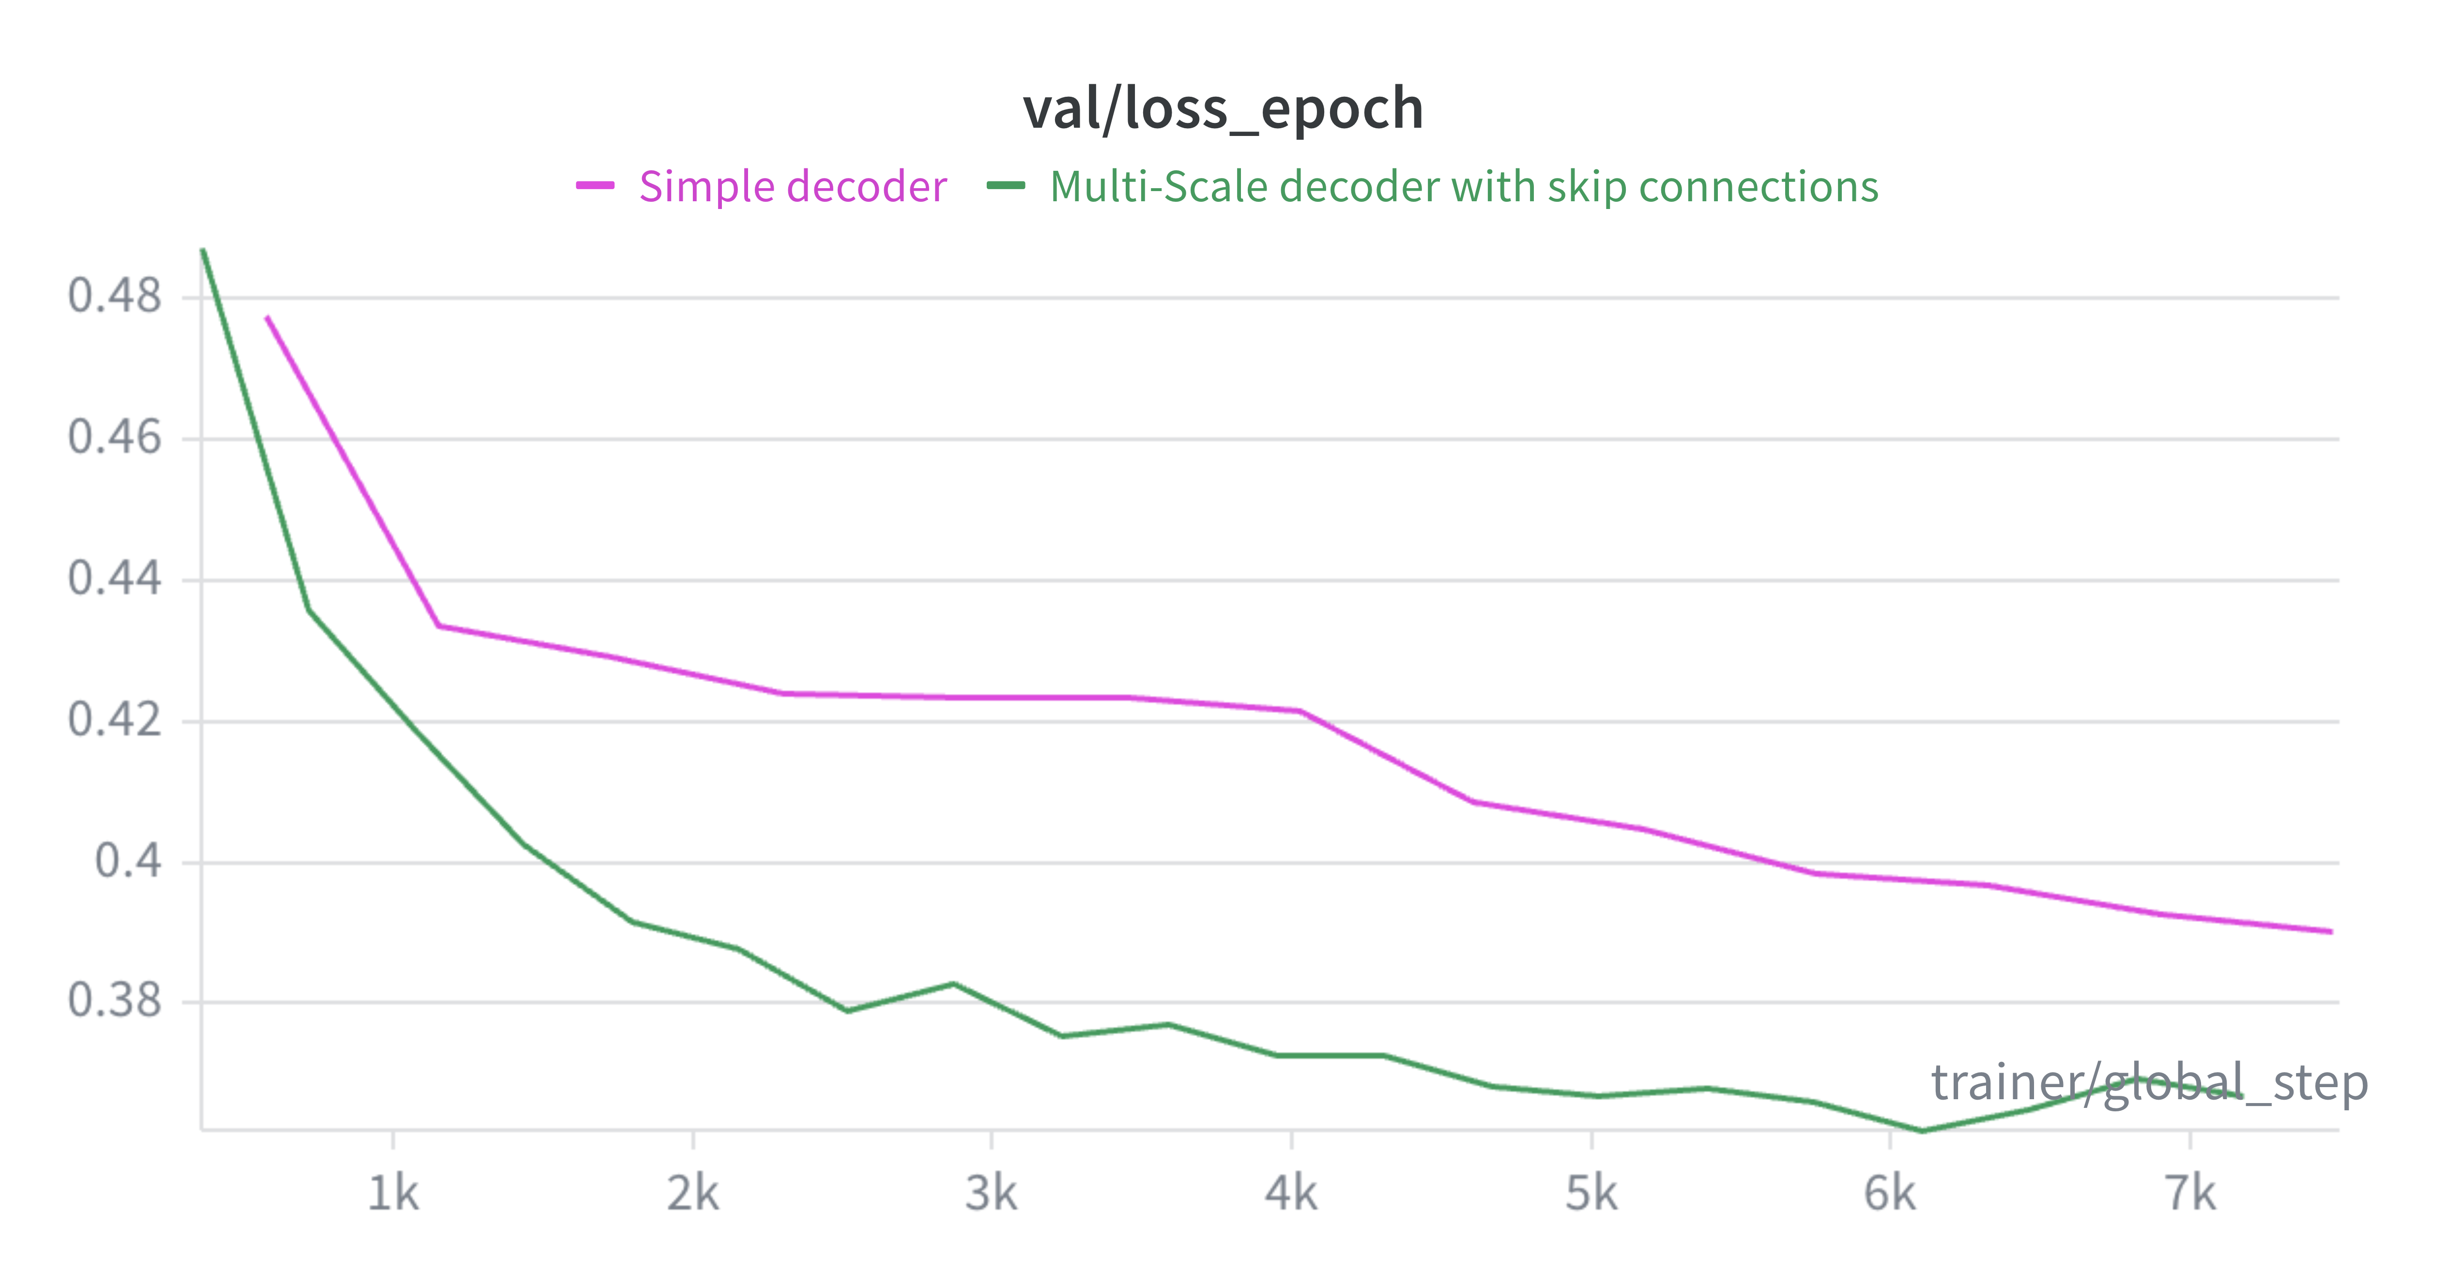
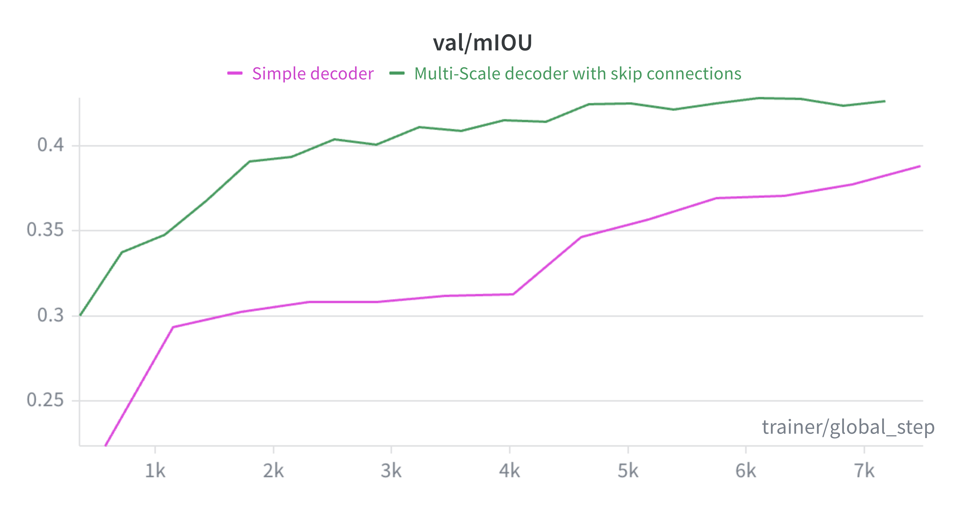
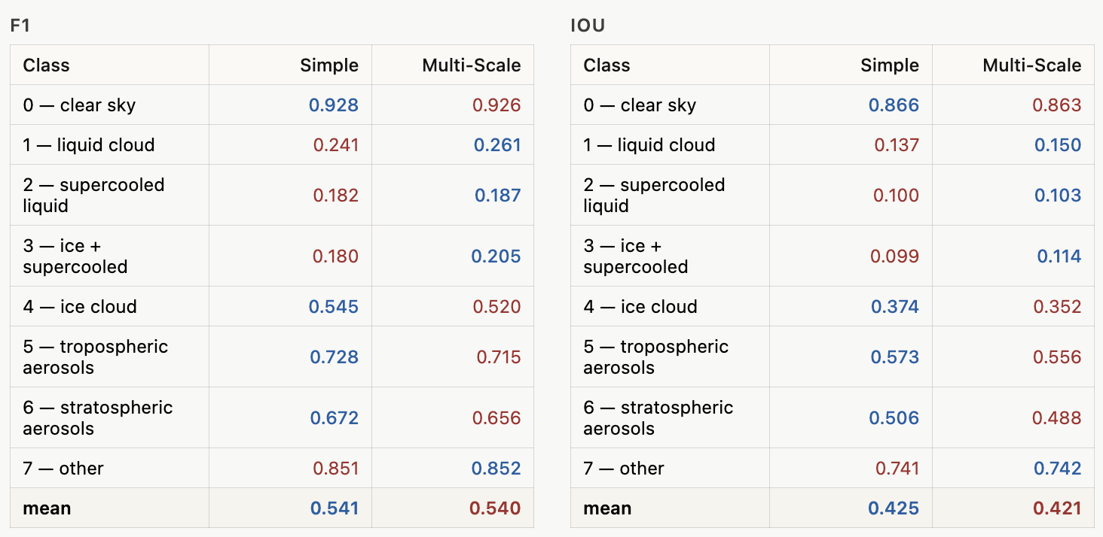
Results
Validation
Test

Slide 9
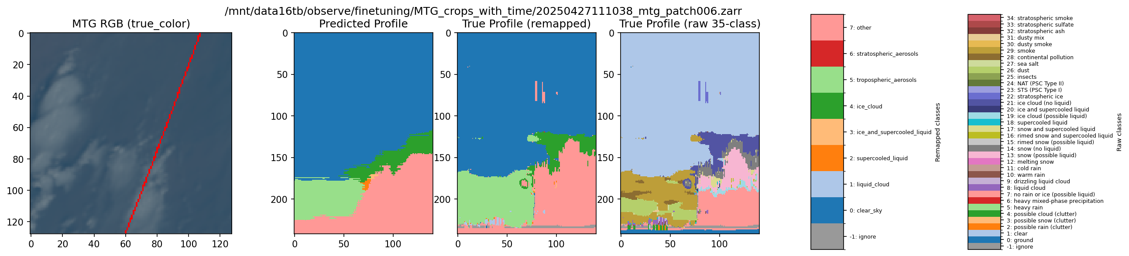
Results

Slide 10
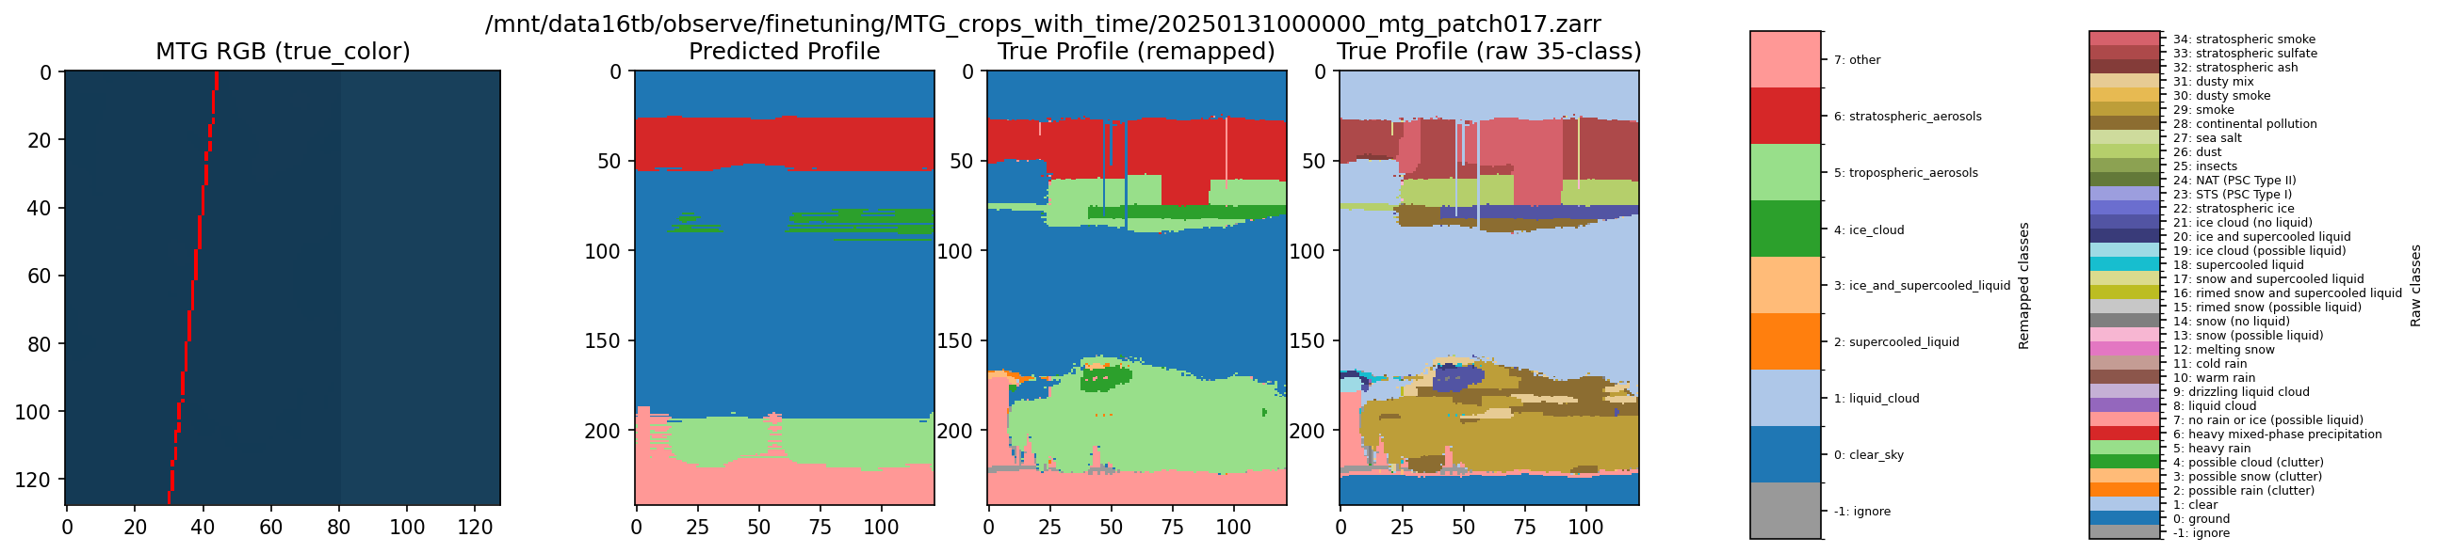
Results

Slide 11
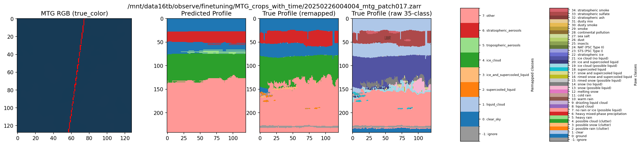
Results

Slide 12
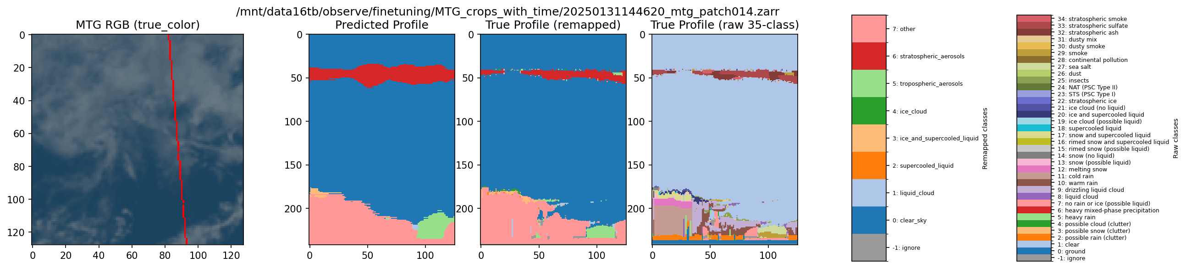
Results

Slide 13
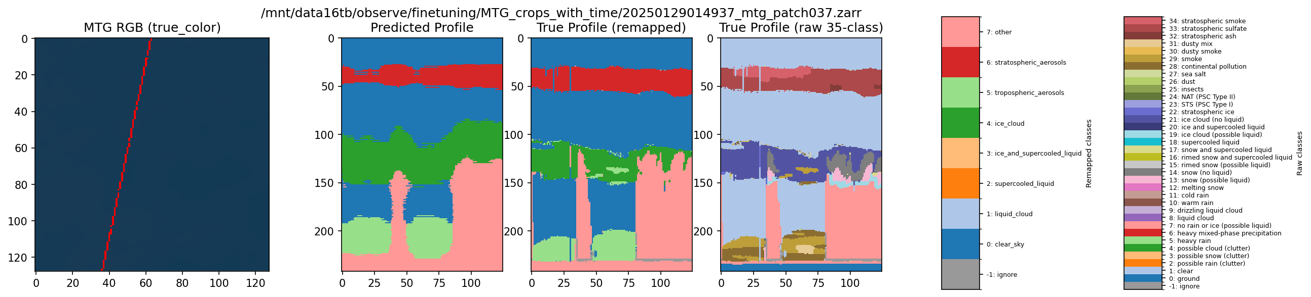
Results

Slide 14
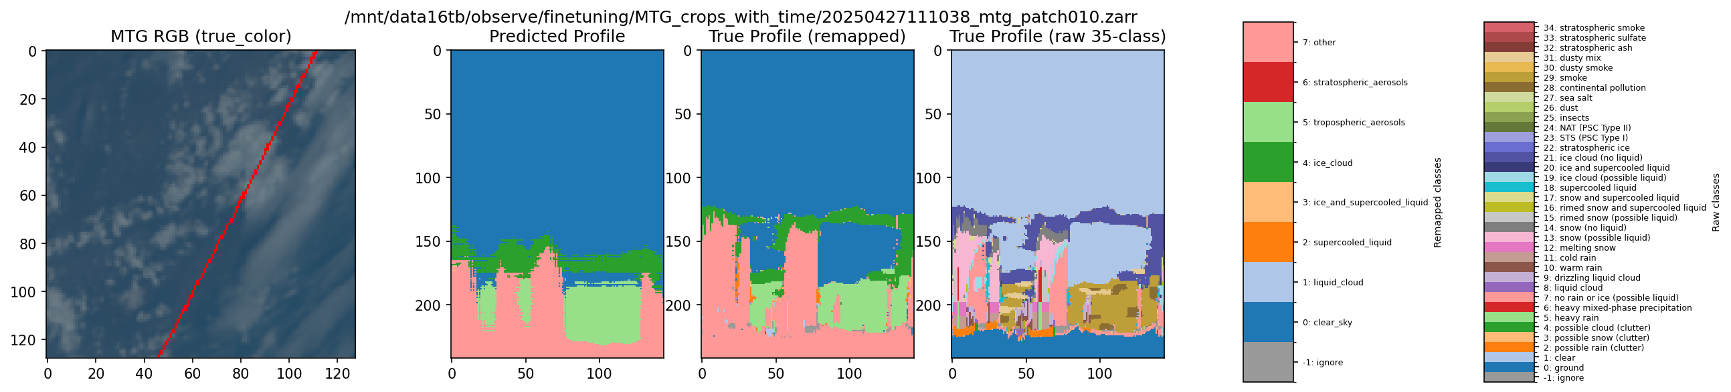
Results

Slide 15
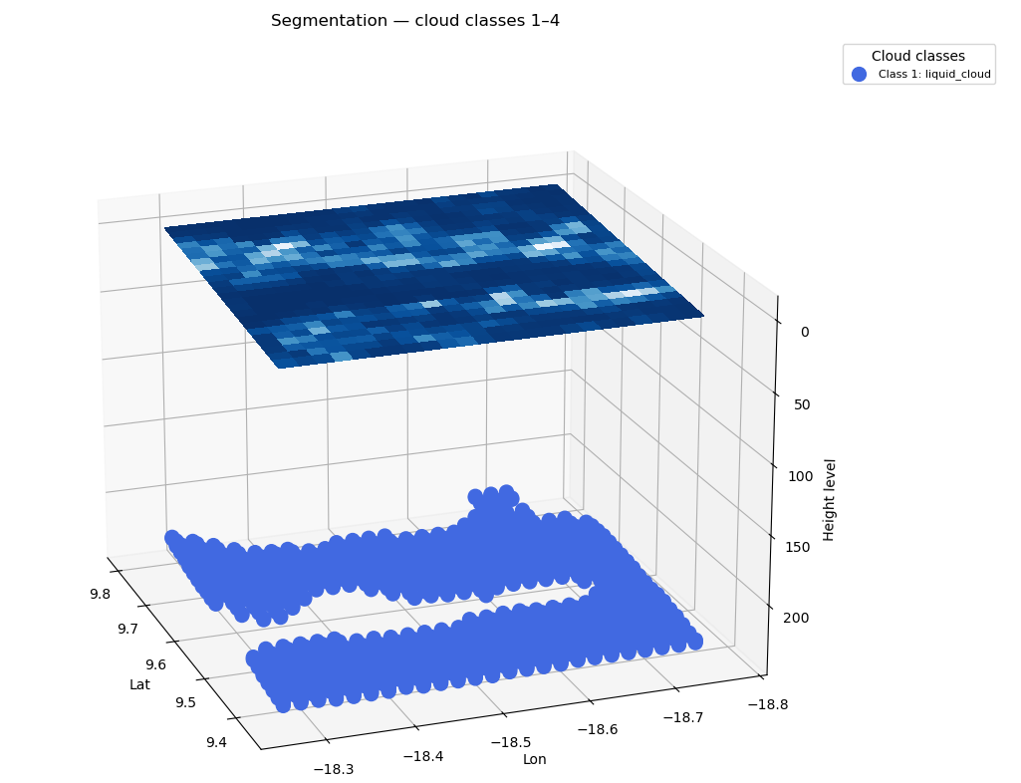
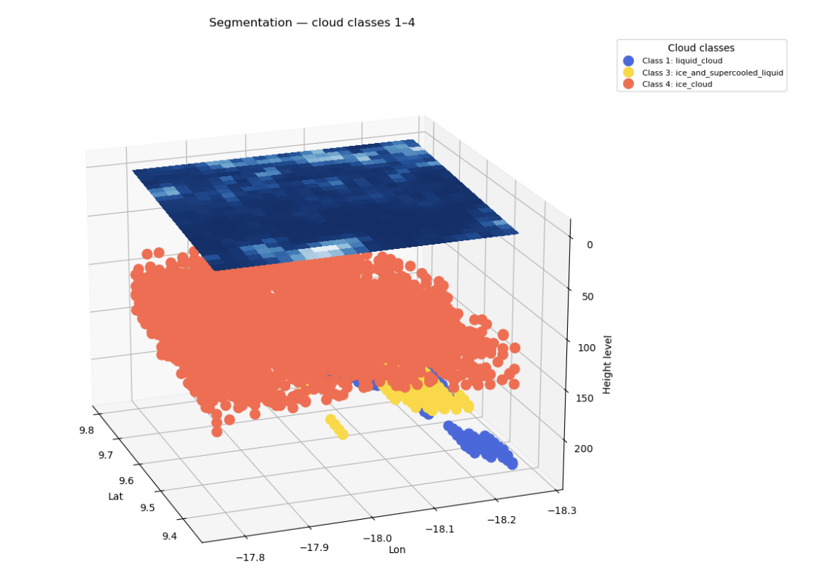
Results - 3D

Slide 16
Key insights
Remarkable results given the input (only MTG)
Strong detection of ice clouds, as well as tropospheric and stratospheric aerosols
Accurate prediction of cloud and aerosol vertical structure
As we continue gathering data from EarthCARE we will explore multimodal schemas
Colocation quality is sensitive to temporal offset: 10 min → poor overlap; 3 min → improved results.
Minority classes (ice, liquid cloud, supercooled liquid) are underrepresented → standard training fails; addressed via custom metrics, loss functions, and class weights.

Slide 17
Next steps
Work on 3D microphysical properties from 2D MTG observations
3D EarthCARE products
Having input from MSI, ATLID and CPR will boost the predictions
Evaluate our predictions with how well each scene reproduce the radiation in the TOA
Evaluate our predictions with ground based cloudnet and aircraft percussion data

Slide 18
Next presentations
Day 3: Wednesday 10 June 2026
Posters

Slide 19
Thank you!
Stella Girtsou, sgirtsou@noa.gr
Dimitra Karkani, dkarkani@noa.gr
Aggelos Georgakis, ageorgakis@noa.gr
Giorgos Giannopoulos, giannopoulos@noa.gr
Alexandra Tsekeri, atsekeri@noa.gr

Slide 20
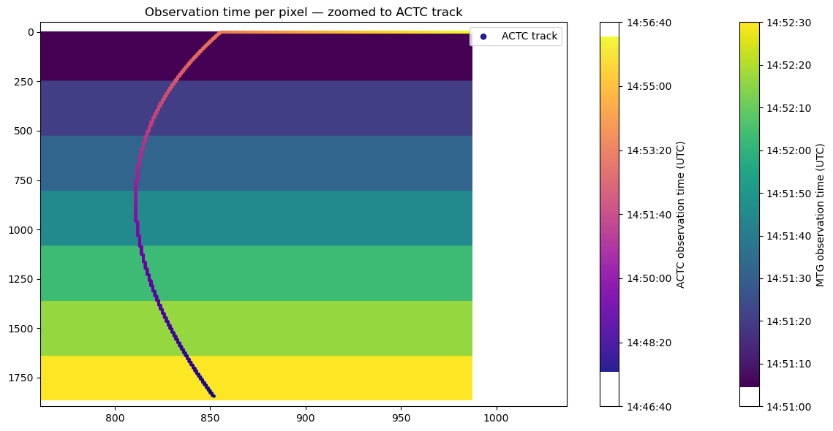
Colocation

Slide 21
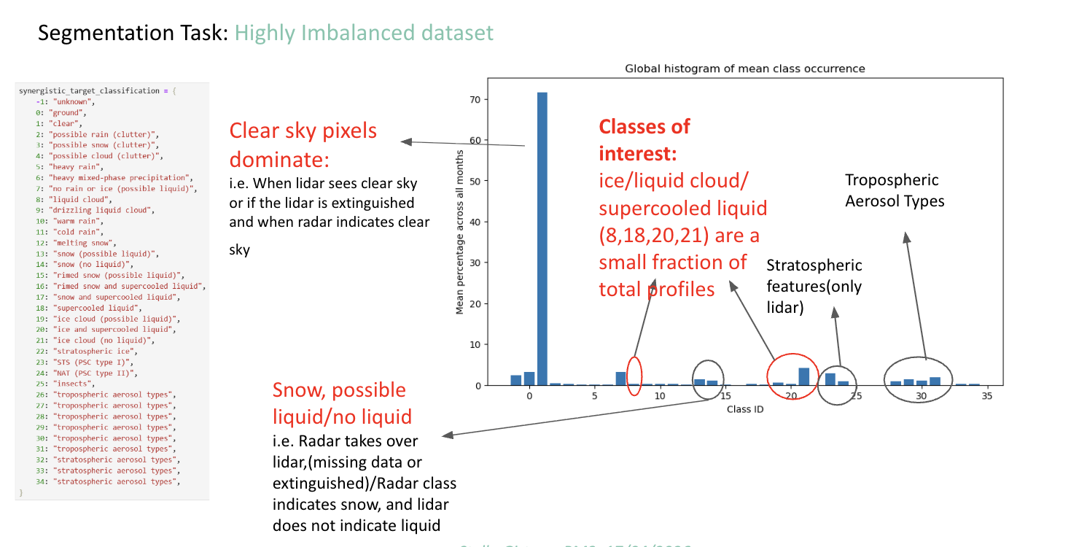
Imbalance

